Slide 1
Updated Plots for BNB with NuMI Phase Space

Slide 2
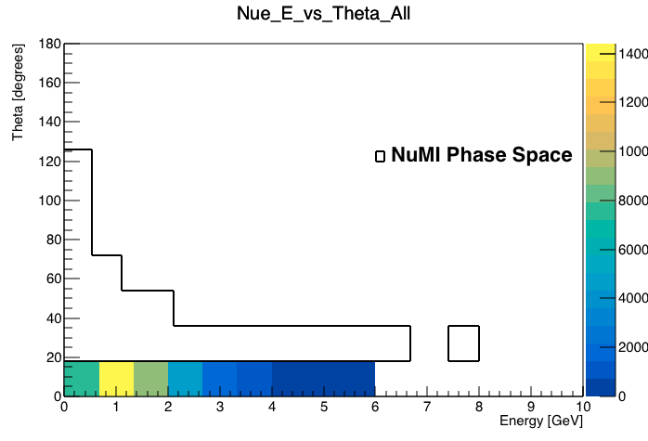
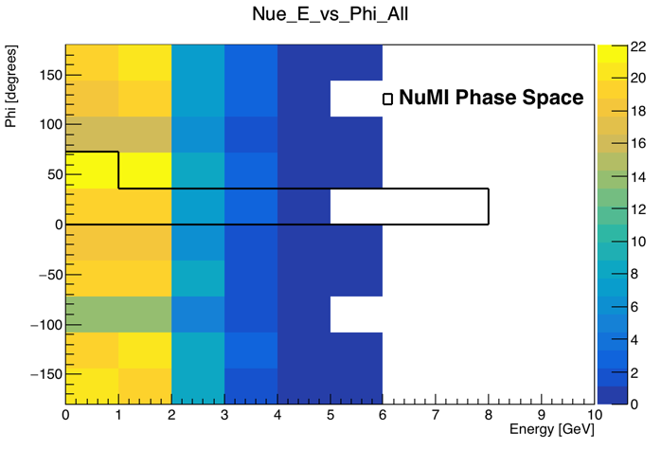
Incoming Nue Kinematics

Slide 3
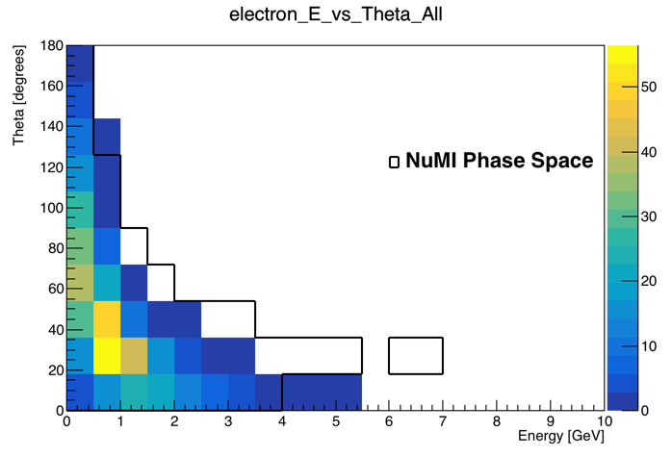
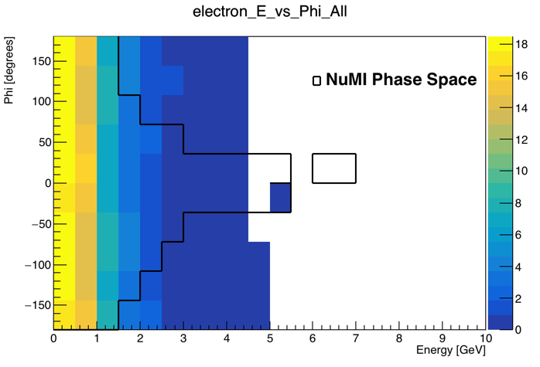
Outgoing Electron from Nue Interaction Kinematics

